Slide 1
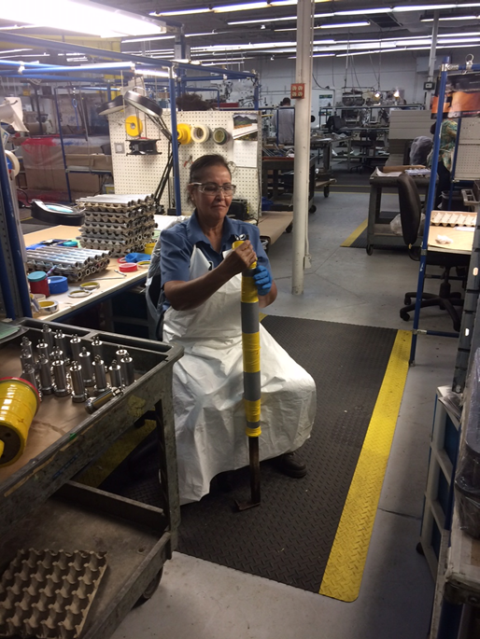
Automation of a Taping Process
Goal was to automate the application of masking tape
Masked parts to be plated (chrome, anodized, acid-etching)
MRO process – variable part geometry
Machine has to accept range of part sizes
Successful outcome

